Slide 1
Examining the Hydrologic Properties of the Missouri River Basin
Rachel Bash, Keqi He, Caroline Watson, Haoyu Zhang

Slide 2
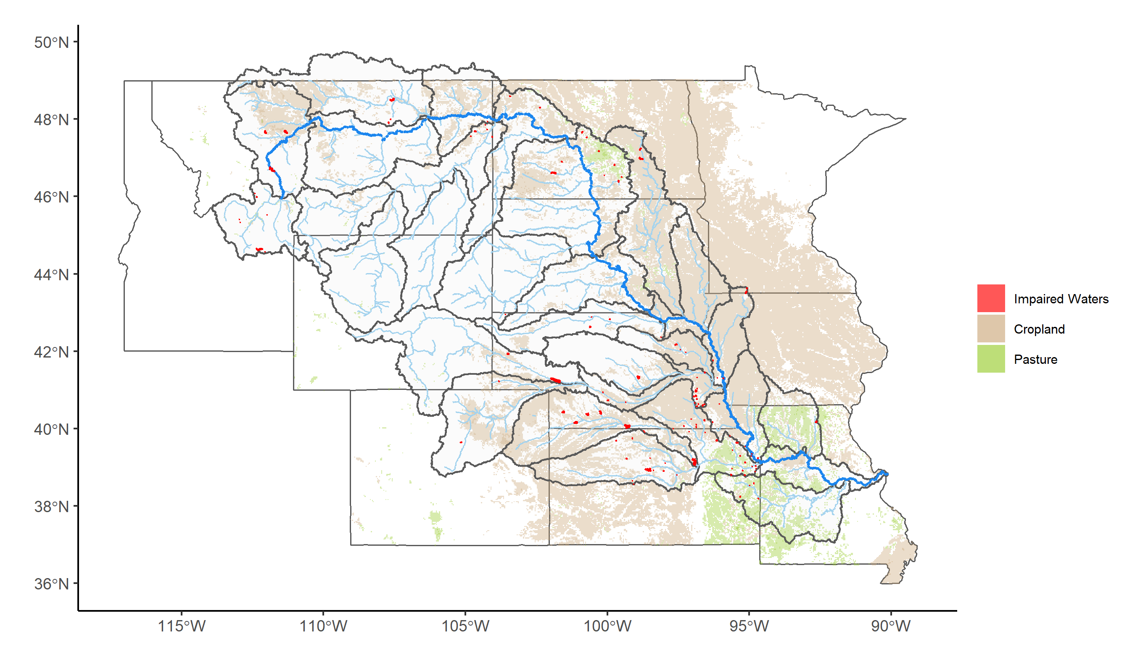
Study Rationale
Insert citations here

Slide 3
Our Research Questions
How have changes in discharge (i.e. water quantity) interacted with nutrient enrichment (i.e. water quality) in the Missouri River Basin?
a) Nutrient levels have increased over time
b) Discharge has become more variable over time
c) Nutrient levels increase with discharge
What effects do specific flood and drought events have on the water quality and quantity of rivers in the Missouri River Basin areas of interest?
a) Rivers will exhibit a flushing behavior due to the land use and type of flow during storms
b) Discharge will decrease during drought due to decreased overland flow.
What factors contribute to the variability of total nitrogen in the rivers?
a) Land use, year, discharge, phosphorus, and HUC region will contribute to the variability of total nitrogen across sites
Given past and current data, what can we predict about the future state of water in the Missouri River Basin?
a) Total flow in the Missouri River Basin is decreasing (non-stationary) over time
b) The future situation of the river basin will see the continuation of current trends of decreasing overall volume of flow.

Slide 4
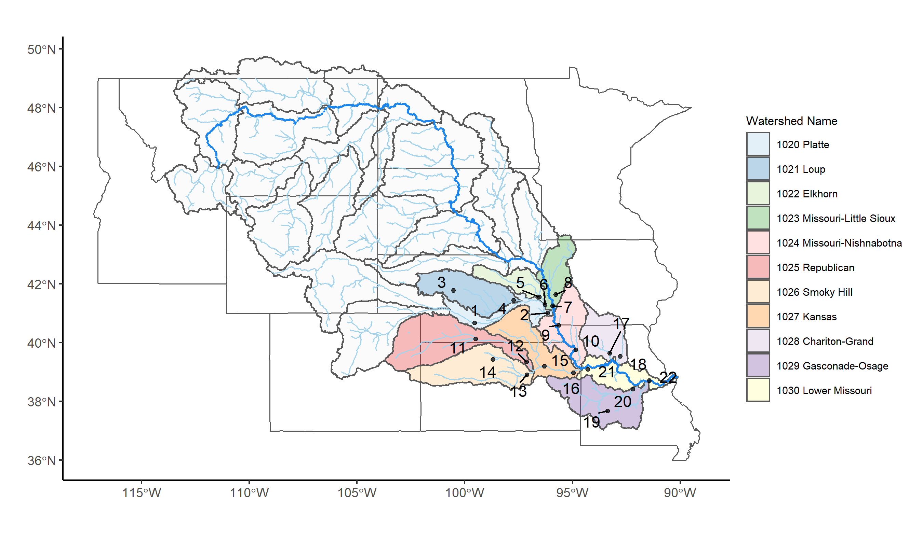
Our Approach
22 sites
Nitrogen, Phosphorus, Discharge, Time
Sites chosen based on HUC4 subbasin from 1020 to 1030

Slide 5
Dataset Information
Used United States Geological Survey (USGS) database called the National Water Information System interface, or NWIS
Downloaded data using ‘dataRetrieval’ package
Variable | Units | Number of Sites
Discharge | Cfs or m³/s | 22
Time | UTC | 22
Nitrogen | mg/L | 22 with daily values 6 with high frequency
Phosphorus | mg/L | 22 with daily values

Slide 6
Exploratory Analysis

Slide 7
Q1: How have changes in discharge (i.e. water quantity) interacted with nutrient enrichment (i.e. water quality) in the Missouri River Basin?

Slide 8
Q2: What effects do specific flood and drought events have on the water quality and quantity of rivers in the Missouri River Basin areas of interest?
Floods
Notes:
Floods

Slide 9
Q2: What effects do specific flood and drought events have on the water quality and quantity of rivers in the Missouri River Basin areas of interest?
Droughts
7Q10 analysis was performed on 6 sites
Include graph with discharge information
Notes:
Droughts

Slide 10
Q3: What factors contribute to the variability of total nitrogen in the rivers?

Slide 11
Q4: Given past and current data, what can we predict about the future state of water in the Missouri River Basin?

Slide 12
Conclusions

